Slide 1
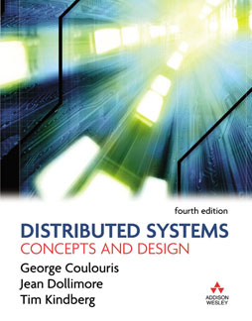
Slides for Chapter 2:
Architectural Models
From Coulouris, Dollimore and Kindberg
Distributed Systems:
Concepts and Design
Edition 4, © Pearson Education 2005

Slide 2
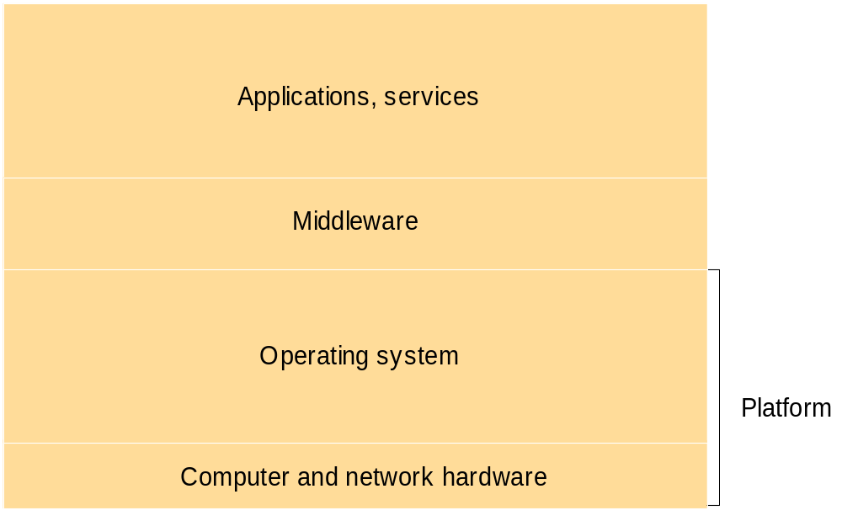
Figure 2.1
Software and hardware service layers in distributed systems

Slide 3
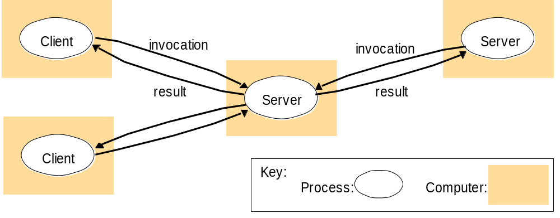
Figure 2.2
Clients invoke individual servers

Slide 4
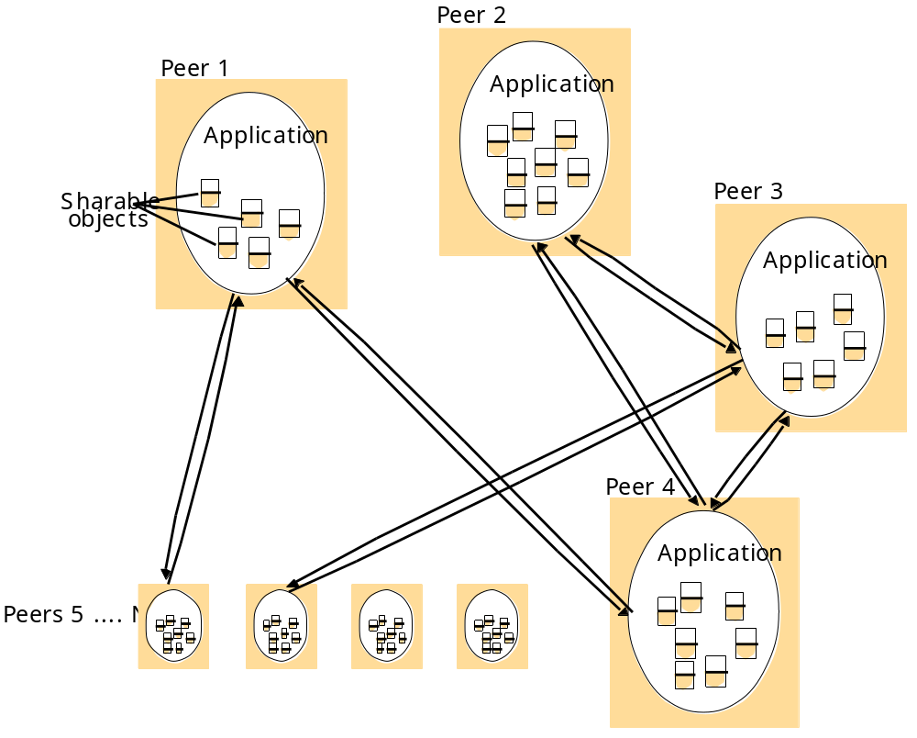
Figure 2.3
A distributed application based on peer processes

Slide 5
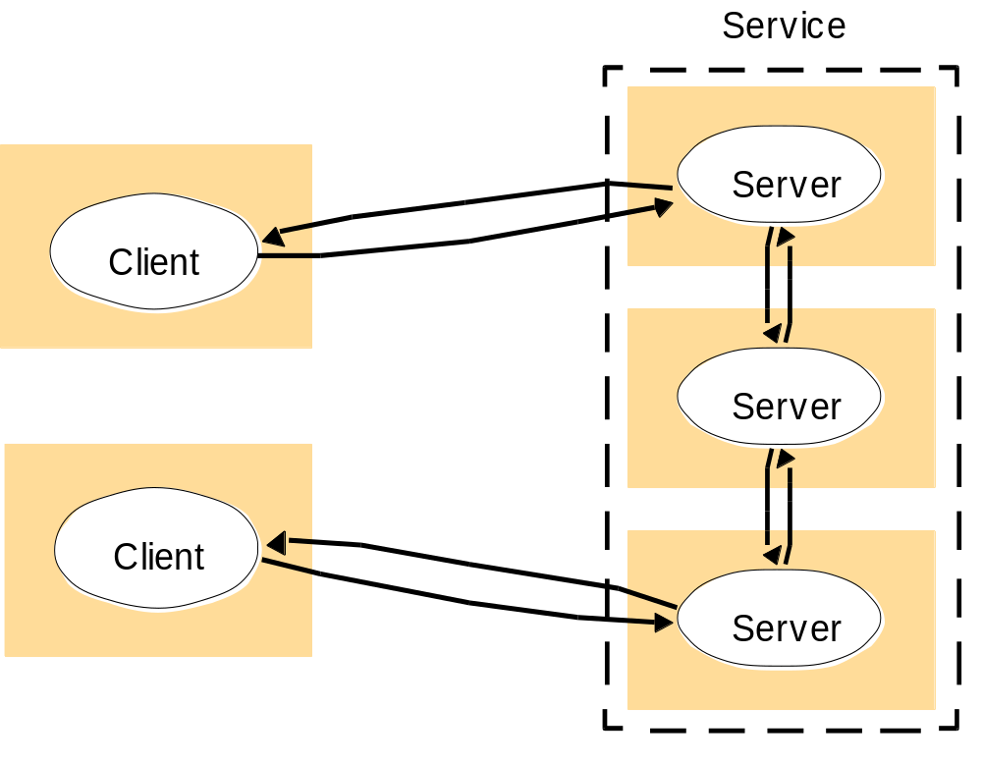
Figure 2.4
A service provided by multiple servers

Slide 6
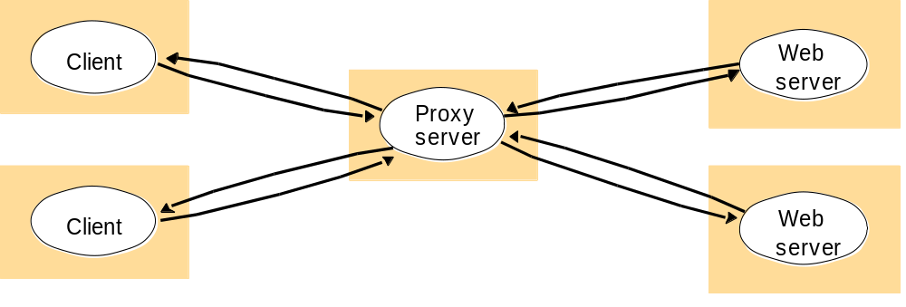
Figure 2.5
Web proxy server

Slide 7
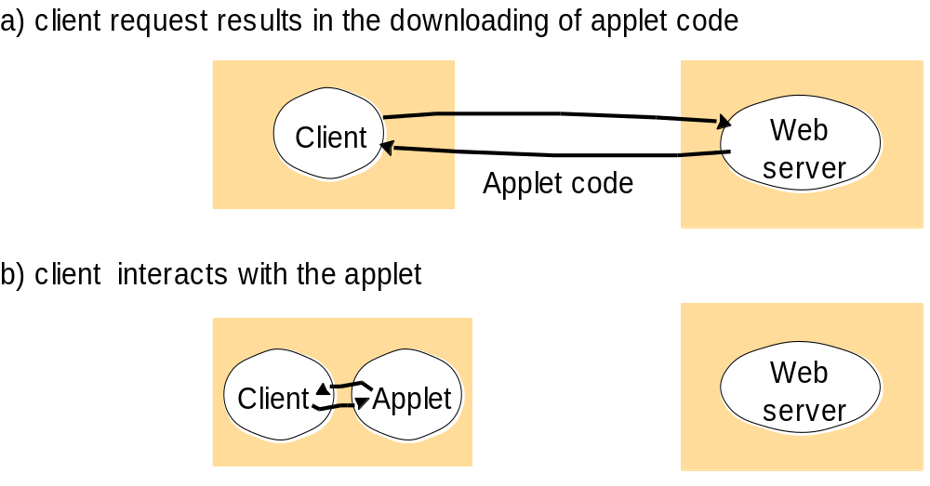
Figure 2.6
Web applets

Slide 8
Figure 2.7
Thin clients and compute servers
Compute server
Network computer or PC
Thin
network
Application
Client
Process

Slide 9
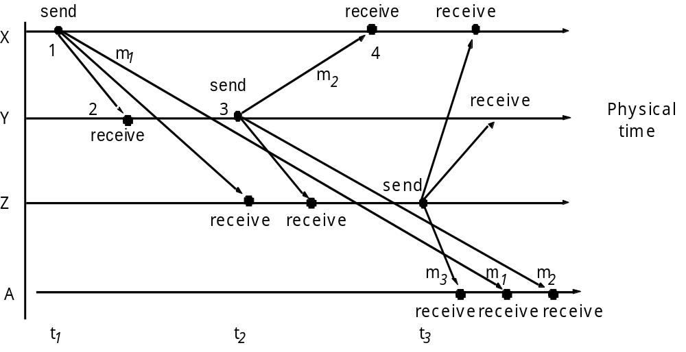
Figure 2.8
Real-time ordering of events

Slide 10
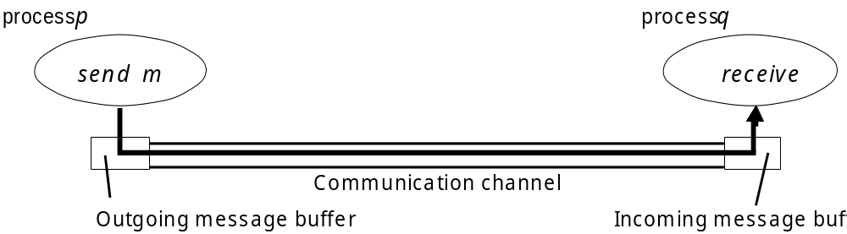
Figure 2.9
Processes and channels

Slide 11
Figure 2.10
Omission and arbitrary failures
Class of failure
Affects
Description
Fail-stop
Process
Process halts and remains halted. Other processes may
detect this state.
Crash
Process
Process halts and remains halted. Other processes may
not be able to detect this state.
Omission
Channel
A message inserted in an outgoing message buffer never
arrives at the other end’s incoming message buffer.
Send-omission
Process
A process completes a
send,
but the message is not put
in its outgoing message buffer.
Receive-omission
Process
A message is put in a process’s incoming message
buffer, but that process does not receive it.
Arbitrary
Process or
Process/channel exhibits arbitrary behaviour: it may
(Byzantine)
channel
send/transmit arbitrary messages at arbitrary times,
commit omissions; a process may stop or take an
incorrect step.

Slide 12
Figure 2.11
Timing failures
Class of Failure
Affects
Description
Clock
Process
Process’s local clock exceeds the bounds on its
rate of drift from real time.
Performance
Process
Process exceeds the bounds on the interval
between two steps.
Performance
Channel
A message’s transmission takes longer than the
stated bound.

Slide 13
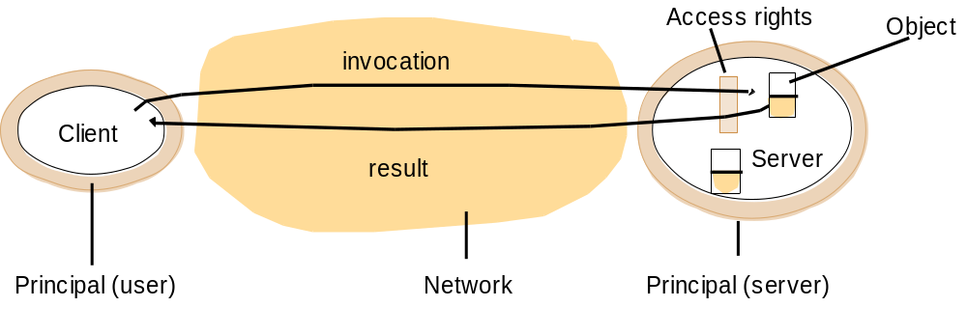
Figure 2.12
Objects and principals

Slide 14
Figure 2.13
The enemy
Copy of
m
The enemy
m’
Process
p
m
Process
q
Communication channel

Slide 15
Figure 2.14
Secure channels
Principal
A
Principal
B
Process
p
Secure channel
Process
q

